Slide 1
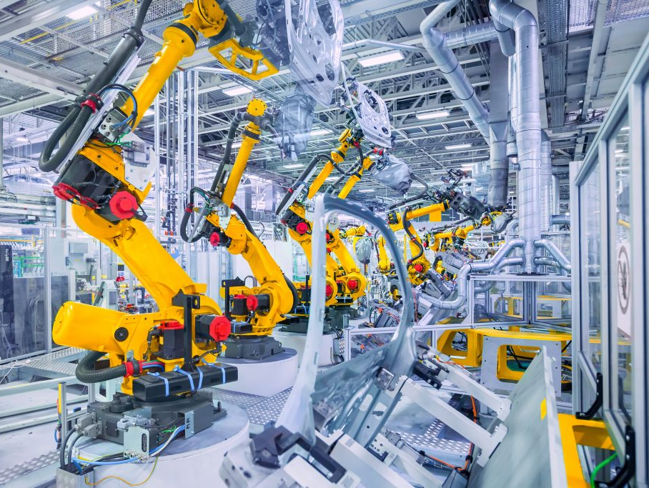
higher Design & Manufacture
Manufacturing Systems

Slide 2
Learning intentions & success criteria
Learning Intentions
Developing my understanding of production processes
Success Criteria
I can recognize different production methods.
I can suggest suitable production methods for a product.

Slide 3
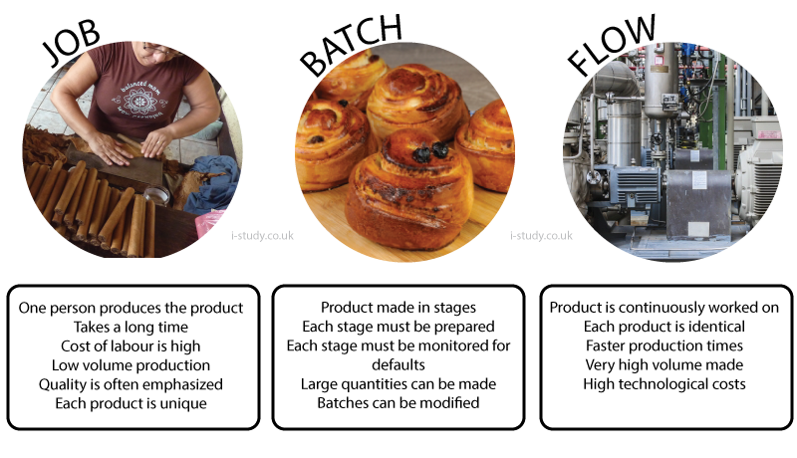
Production methods
Not all parts, components or products are made in the same way.
Sometimes we have to select a production method that is best suited to our product.

Slide 4
Job production
Used for one-offs, single items or very low volumes.
Items produced to very specific customer specifications but cost is high.
Production requires a highly skilled workforce and is labour intensive.

Slide 5
Batch production
Large quantities are produced using this method.
Each operation is completed for a batch before the next operation begins.
Often used by small scale furniture manufacturers who have to produce 100 identical products.

Slide 6
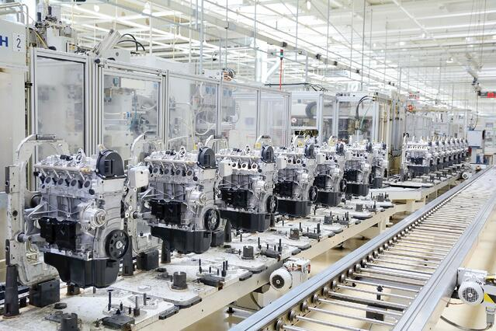
Line production
Products are made and assembled during a continuous process.
Operations are performed sequentially and moved along the line.

Slide 7
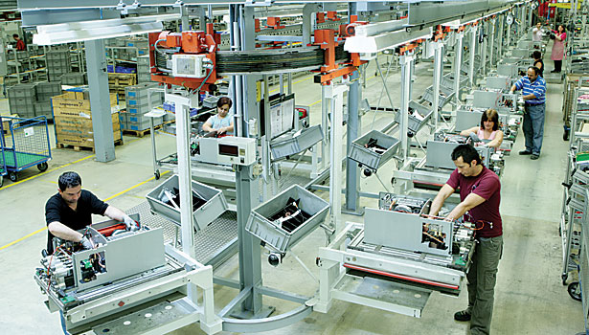
cell production
Operations are performed by a small, multi-skilled group or ‘cell’.
Each member of the cell can perform the tasks of the others.
Each cell is responsible for the productivity and quality of their products.

Slide 8
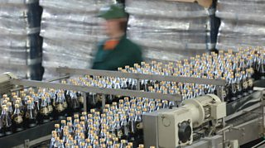
flow production
Very similar to line production but with very high volumes.
Production is continuous, often 24hrs.
Unit costs can be very low.

Slide 9
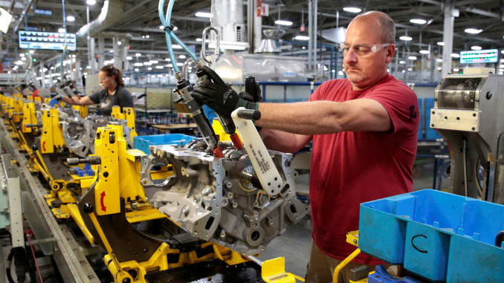
Manufacturing systems
Manufacturing systems are the different ways in which manufacturing can be carried out.
Manufacturing systems have changed dramatically over the last century; now there are a variety of systems, each with different running costs.

Slide 10
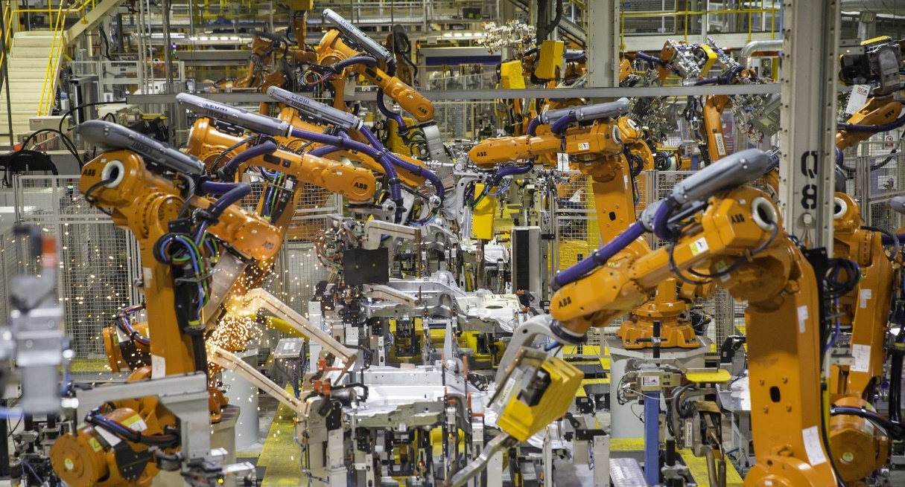
Manufacturing systems
Choosing a systems depends on
Market demands for the product
Which in turn determines its volume of production
Also affecting the choice of system:
Tooling costs
Factory layout
Personnel required

Slide 11
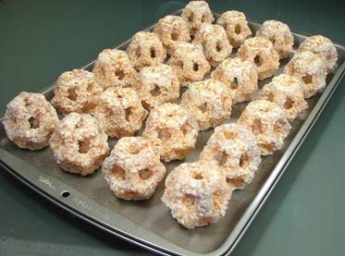
Small batches
Small batches are one offs.
Small batches are typically produced by skilled craftsmen in a traditional workshop environment.
Small batch production is:
Time consuming
Expensive
Labour intensive
However, it does allow total flexibility and the opportunity to be custom made.

Slide 12
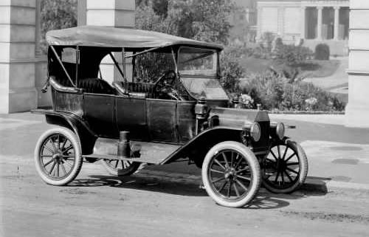
Assembly lines
Assembly Lines became common in the 1930’s. It involves hundreds of workers organised in a line to perform tasks in sequence.
Workers were organised either individually or in groups, staying in the same place to perform the same task all day.
These assembly lines were inflexible, workers were trained to do one job with no real concept of the overall product.
This meant that if there was a breakdown or hold up, everyone would have to stop. The first successfully produced product using this mass-production technique was the ‘Model T Ford.’

Slide 13
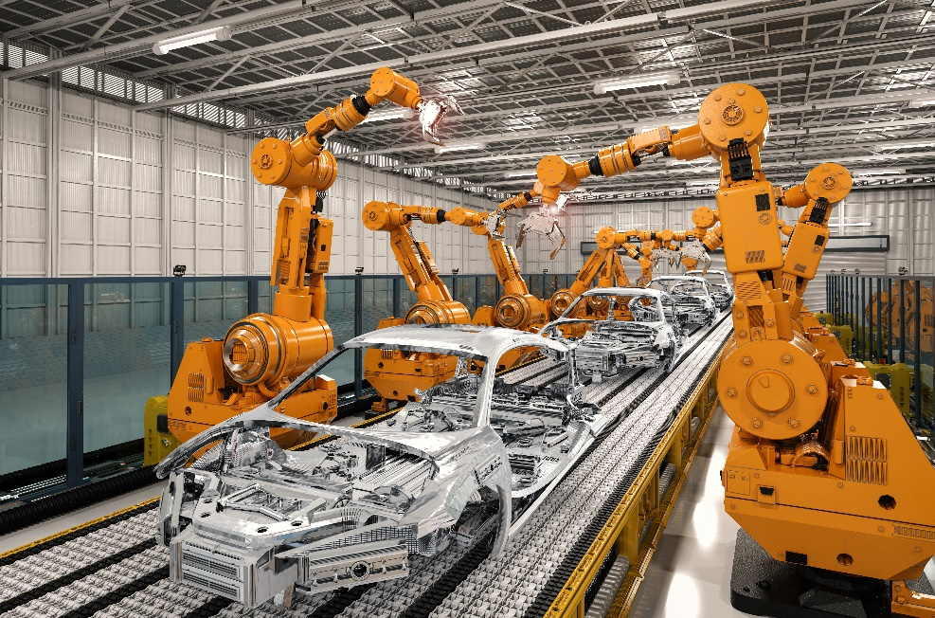
mechanisation
Over time, with the evolution of technology, assembly lines were mechanised.
The use of hand operated machines made production processes quicker and more accurate.
Assembly lines still exist today but they are either semi or Fully automated.
Automation depends on computer controlled robots and machines, programmed and controlled by skilled operators.
Efficiency is much greater, as the accuracy and the overall quality of the product.

Slide 14
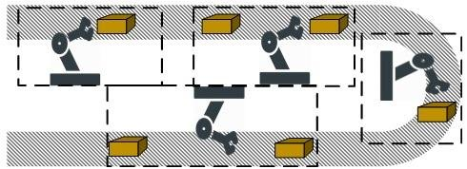
Flexible manufacturing
Technological developments have led to more Flexible Manufacturing systems of production.
Flexible manufacturing brings together computer controlled machine tools as well as robotic handling and assembly of parts.
Machines or manufacturing cells are linked together normally in a U-shaped formation.

Slide 15
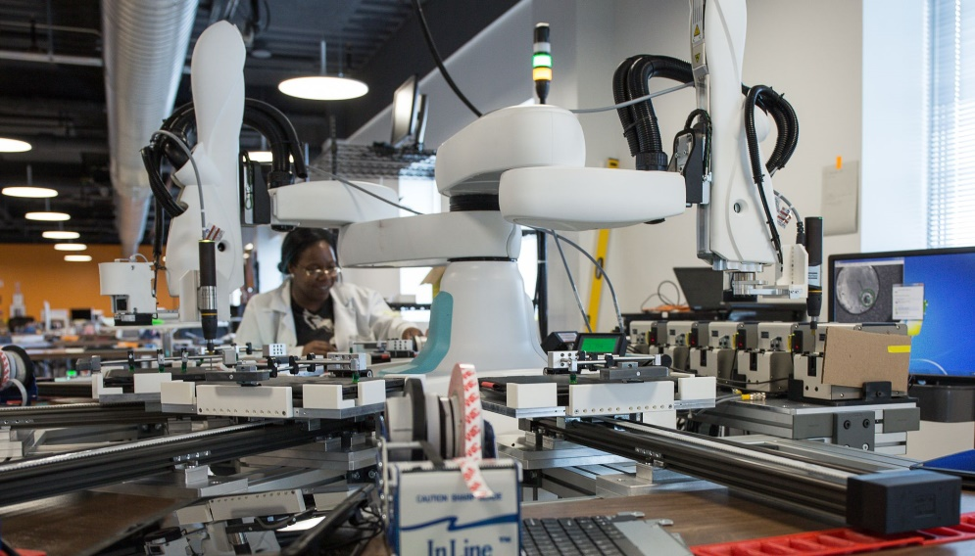
Flexible manufacturing advantages
Production lines can be changed quickly to produce different products.
Teamwork and productivity are improved as personnel are closer to each other.
Operator fatigue is reduced, eliminating human error.
Quality assurance and control is readily checked and monitored.
The product is assembled by a team of people or cell. All members of the team can do any job and all are responsible for quality assurance.

Slide 16
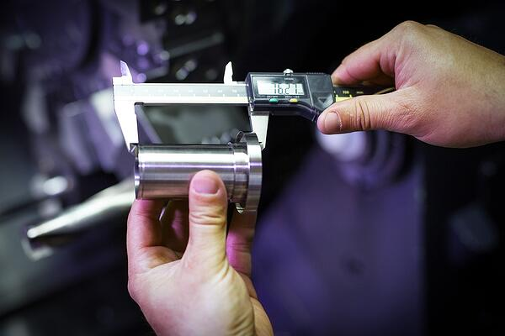
Total quality management
These major changes in manufacturing systems are now being driven by the concept of:
Total Quality Management (TQM).
This is a management approach to long-term success through customer satisfaction.
Improving processes, products and services
This involves the elimination of
Costs of inspection
Rectifying mistakes
Preventing mistakes.

